Slide 1
Smart Contract

Slide 2
Overview
Ethereum & smart contracts
Solidity tutorial
Smart-contract programming
Ethereum virtual machine (EVM)

Slide 3
Two Types of Accounts (address) on Ethereum
Externally owned accounts (EOA): address = H(PK)
contracts: address = H(CreatorAddr, CreatorNonce)
Notes:
H is Keccak-256 hash function. For both addresses computation, it computes Keccak-256 hash and then outputs the last 20 bytes (i.e., 160-bit). The CreattorNonce is the number of transactions the CreatorAddr has done.

Slide 4
Smart contract
smart contract is a user-defined program running on BKC.
smart contract has its account (identified by an address), CA, described by the following.
1. Nonce: it will increase every time this account sends a
transaction;
2. Balance: The amount of Ether it has now; it can receive or
send Ether.
3. code: the program of this smart contract
4. Data: the storage variables in this smart contract
Smart contract address is determined by sender address (who sends SC to blockchain) and sender nonce (which increases after each tx of this sender).

Slide 5
EOA vs CA
So Ethereum has two accounts: EOA and CA
CA has its address but no private key; it has a state (nonce, balance, code, Storage Data)
EOA has its address with a private key; it has state (nonce, balance)

Slide 6
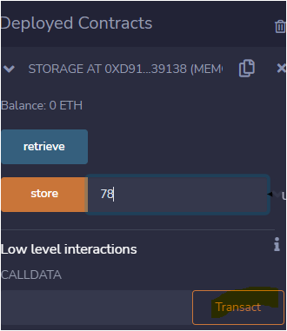

Ethereum transactions
Two transactions:
- from EOA to EOA to transfer Ether only
- from EOA or CA, to CA, to deploy/execute CA; this tx inf
is called a message.
Two types of Messages:
1. Given a smart contract C, tx encodes C to deploy it to
blockchain at address of CA.
2. tx encodes data (CA address, function name, args) to
execute the deployed contract on the blockchain.
Contract address
function names
arg value
send tx

Slide 7
Smart contract life cycle
Develop code:
You write the source code of a smart contract
• Compile code:
You compile the source code to bytecode.
Deploy code
You sends tx encoding your smart contract to blockchain
Execute code
Someone (including you) sends tx encoding the function (to be
invoked) and its arg values.

Slide 8
outline
Ethereum & smart contracts
Solidity tutorial
Smart-contract programming
Ethereum virtual machine (EVM)

Slide 9
Solidity
Solidity: A programming language for smart contract. The program runs on blockchain
• Online Development Platform: https://remix.ethereum.org/
Reference Book:
Andreas M. Antonopoulos and Dr. Gavin Wood, Mastering Ethereum, O’Reilly Media Inc, 2018.
Online documentation (current version: 0.8.19):
https://docs.soliditylang.org/
Notes:
Another popular choice of development platform is Truffle (on your local computer) using the blockchain simulated by Ganache. Truffle provides a more comprehensive and feature-rich development environment suitable for larger projects, while Remix offers a lightweight and accessible web-based IDE for quick prototyping and experimentation.
Our teaching uses Remix to get away from the complication from things other than the smart contract itself.

Slide 10
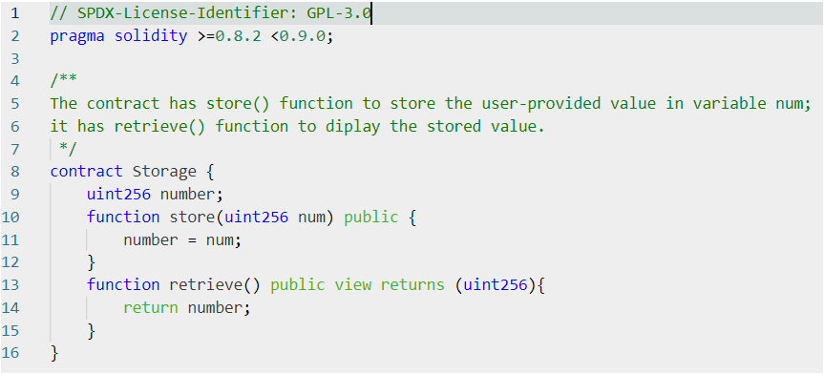
The first solidity program: Storage.sol
Open source license identifier
Compatible solidity versions:
at least 0.8.2 but not 0.9.0 or higher
Contract named Storage
Notes:
Pragma solidity is compiler directive that tell you which version of solidity can be used to compile the program. In the above program, it indicates that at least solidity 0.8.2 but should not use solidity 0.9.0 or higher version. You might also see solidity ^0.8.2 in a program, this asks to use the exact solidity 0.8.2 for the compilation. The file name better uses the contract name to be more informative.

Slide 11
Interpretation
Integer:
- uint256 for unsigned integer of 256 bit; similarly uint8;
- int256 for signed integer of 256 bit; similarly, int8.
returns (uint256):
This indicates the type of the returned value of this function
public:
This indicates the function retrieve() can be called externally.
view:
Executing retrieve() should not change other variables in program
Notes:
uint256 is the same as uint which can take the maximum value 2^256-1. int (which is int256) takes value between -2^255 to 2^255-1. You might see constant function modifier. Somewhere. This is the older version of view type and deprecated now. view type function can be called without any cost (no gas usage and no signature) and you can call it by your local node (if it stores the whole blockchain) without broadcasting to the network.

Slide 12
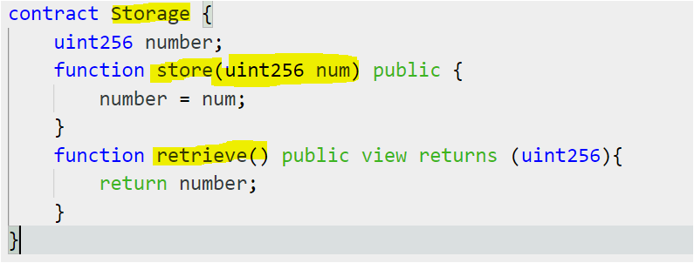
Interpretation (cont)
Contract name
Member function
Member function
Notes:
Public function can be executed by any account (either an EOA or CA). In contrast, if you change public to private for retrieve( ), then after deploy, it is the function is no longer accessible. You might also see external functions. External function can only be called externally while public function can be called by external and internal functions. You might also see internal function. Internal function can be called by current contract or its derived contract while private function can not be called by derived contract. Variable number (called storage variable, part of the contract state) can also be accessed by a getter function number( ).

Slide 13
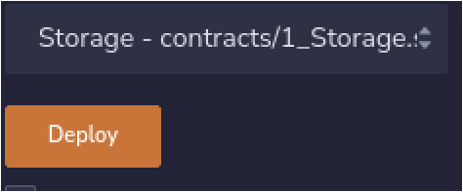
Compile and Deploy a smart contract
Compile (on Remix):
Deploy (Environment: Remix VM): This will send tx to deploy the already compiled contract to the remix IDE’s own blockchain. This is not a blockchain on the public network. It is a simulated blockchain only. This is fine at the develop stage.
Notes:
When you are familiar with solidity, you can use Javascript tool Truffle to automatically deploy the smart contract.

Slide 14
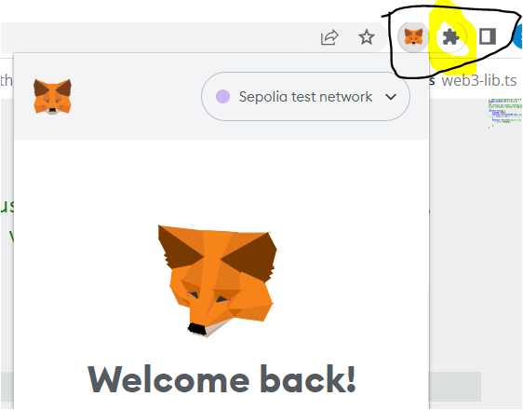
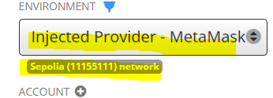
Deploy a contract on Ethereum Testnet
Install MetaMask on your Chrome/Firefox.
Login MetaMask
Choose Environment: Injected provider):
This will show one of your MetaMask
account.
Now press deploy button.
MetaMask installed on Chrome

Slide 15
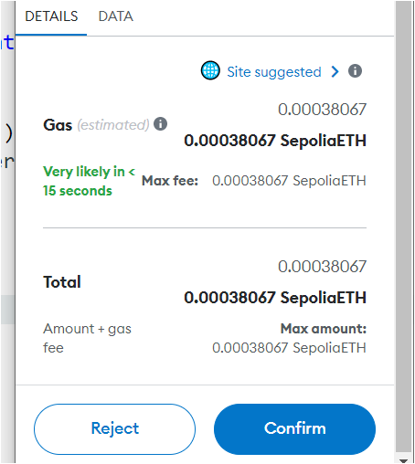
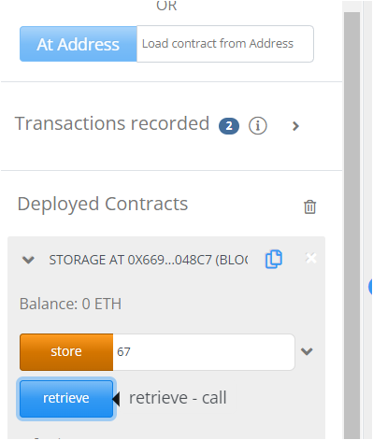
Deploy a contract on Ethereum Testnet
This will ask your MetaMask for confirm
Then, the tx to deploy your smart contract will be sent to a EthereumTestnet.
Here is my contract address: 0xf1542Ef5c31F02bD05728c8A46cBe1f08112B16D
(to see tx, go to https://sepolia.etherscan.io/)
You can also access this deployed contract: input the address in the box next to At Address and click and will see the contract as in the picture. Run store or retrieve function will send a tx to Ethereum blockchain

Slide 16
Gas, Gas price and tx fee
The tx sender needs to pay tx fee to the miner
Recall: Bitcoin tx fee is the difference of input and output values.
On Ethereum blockchain, the
tx_fee=work_amount × price_per_unit_work
work_amount is called gas; it is the amount of computing work by miner in order to include a tx on blockchain
price_per_unit_work is called gas price; it is the amount of Ether the sender is willing to pay to the miner for each gas computation.

Slide 17
Gas
The gas for a tx is defined as gas=21000+X.
21000 accounts for the basic computing cost by miner:
- verifying signature for tx and more
- transfer Ether between different account cost 21000 gas.
X counts for the cost executing the contract functions. This is determined by the basic operations in this contract function.

Slide 18
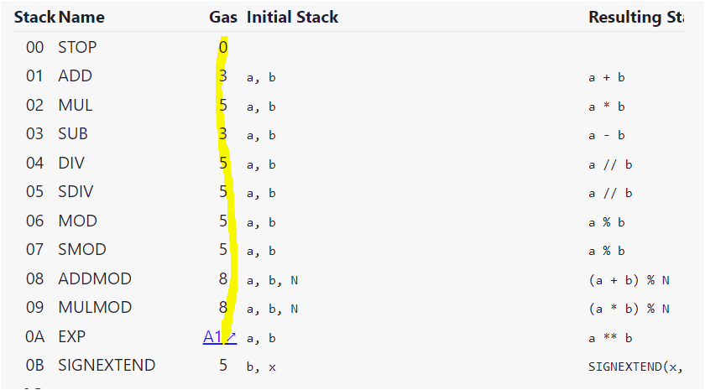
Gas for some Ethereum Opcodes
You should regard this site as the source for what operations you can use in your contract.
https://ethereum.org/en/developers/docs/evm/opcodes/
0A exp to compute a^{b} with cost depends on b; details see
https://github.com/wolflo/evm-opcodes/blob/main/gas.md

Slide 19
How to Estimate Gas (fee)
If you use MetaMask to send your tx, MetaMask will give you the gas amount estimate (where it in fact gives the gas fee).
Here is the example for deploying store.sol on test blockchain.
If you can estimate gas with web3 (but we will not study this).

Slide 20
Gas limit and Execution Fail
The gas estimate is hard to be accurate. It also depends on the execution.
Sender specifies a gas limit he is willing to pay. If the execution is higher than the gas limit, the execution will stop but the used gas will not refund.
If your gas usage is less than the limit, you only pay your usage.
If the execution fails, the gas will be charged till the failure point.

Slide 21
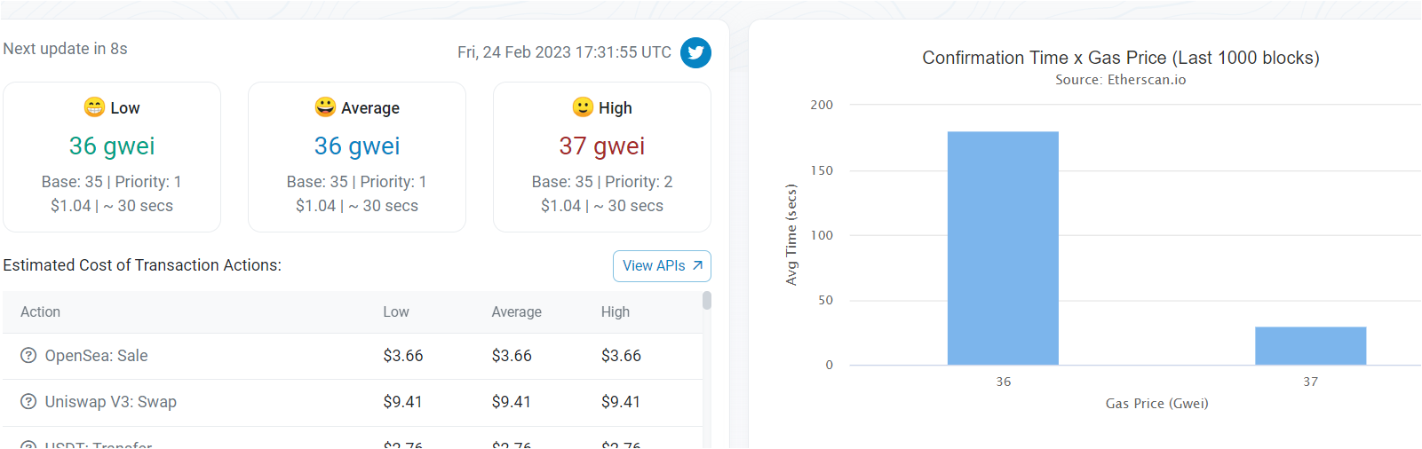
Gas Price
Gas price is determined by “market” (higher price allows your tx to be more likely to be included in a miner’s block).
You need to specify the price you want to pay.
Price suggestion for main net, see
https://etherscan.io/gastracker

Slide 22
outline
Ethereum & smart contracts
Solidity tutorial
Smart-contract programming
Ethereum virtual machine (EVM)

Slide 23
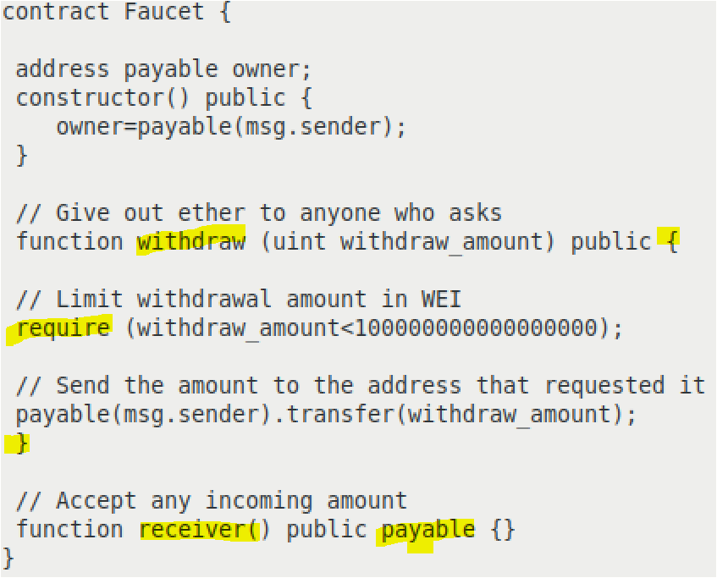
A simple Faucet contract (to be explained)
Condition to continue
Transfer Ether from contract address to address that invokes withdraw() function.
Contract can accept Ether.

Slide 24
Address object: address
There are two types of address: address and address payable
Ex. address payable alice;
It has some attributes or methods (we only give two).
alice.balance: return the ether alice address has.
alice.transfer(178): this transfer 178 wei from the executed contract to alice.
address (without payable) does not have transfer method.

Slide 25
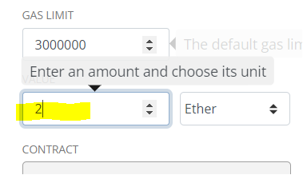
Transaction/Message: msg object
msg is an object that basically represents the tx from the sender.
If tx is to deploy a smart contract, then msg is an object contains the information of this deployment transaction.
If tx is to invoke a function of contract, then msg is an object containing the information of function and its input, sender/receiver.
msg has several attributes and methods (we study two here).
msg.sender: the sender address object in tx (represented by msg)
msg.value: the amount of ether sent to contract address.

Slide 26
require statement
Ex: require(a<1000, “number a is too big”)
It will check if a<1000 is satisfied. If no, it will send error message “number a is too big”.
You can use require(a<1000) only (without the 2nd input).
If require is not satisfied, the execution will throw an error and the state of contract will revert to the starting state. The gas will be charged till the failure point.

Slide 27

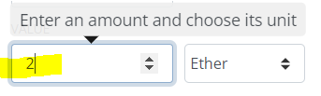
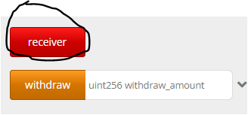
payable keyword
If a function has a keyword payable, then it can accept ether.
After deploying, you can input 2 Ether and invoke receiver function to send it to the contract.
payable(alice) makes address alice as address payable type.

Slide 28
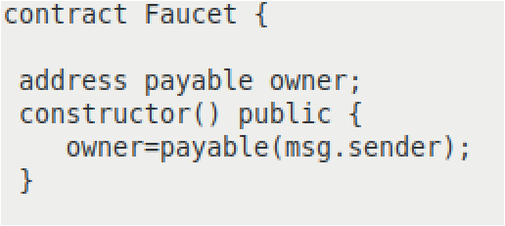
contract constructor
You can use constructor to initialize global variables
Constructor is run only once.
The sender that deploys the contractor will remain as the owner throughout the lifetime of this deployed contract.
Notes:
You also have constructor with input: constructor (uint8 _number) public { number=_number; } . You will be asked to provide the input _number when you deploy the contract.

Slide 29
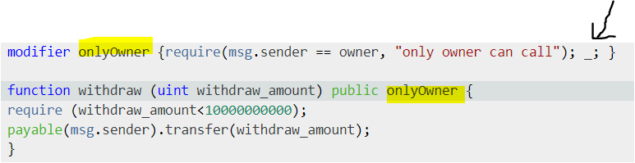
function modifier
Question: how to impose access control to a function execution?
This can be done by function modifier.
ex. want to modify faucet s.t. only the owner can withdraw.
Placeholder (_;) is replaced by the code of the function that is being modified.

Slide 30
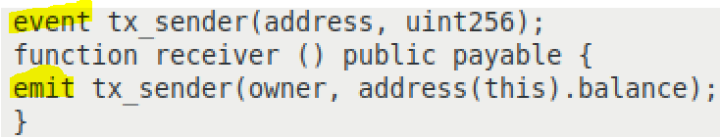
Events
It is possible to print some events for the contract execution.
ex. when one deposits, we want to report the owner and the current balance.
use event to define an event
use emit to output the event; you can see it from your tx receipt.
this means the contract itself; address(this) is the contract address.
Notes:
The event usually is used to monitor the contract state change. For example, with event tx_sender event, you know owner’s balance has been changed.

Slide 31
Contract Transactions
To: 32-byte address (to=0 means creating new account)
From: 32-byte address
Value: # Wei being sent with Tx
gasPrice, gasLimit: Tx fees (later)
data: what contract function to call & arguments
if To = 0: create new contract
[signature]: if Tx initiated by an external owned account
Notes:
nonce must match current nonce of sender in sender’s account data. When Tx processed successfully, nonce in sender’s account data is incremented by 1.

Slide 32
Create New Block by Miner
Miners collect Tx from users:
⇒ run them sequentially on current world state
⇒ new block contains a list of Txs

Slide 33
The Ethereum blockchain: abstractly
prev hash
prev hash
…
…
Tx
Tx

Slide 34
EVM mechanics: execution environment
Write code in Solidity (or another front-end language)
⇒ compile to EVM bytecode
⇒ miners use the EVM to execute contract bytecode in response to a Tx

Slide 35
The EVM
Stack machine (similar to Bitcoin)
max stack depth = 1024
miner keeps gas
contract can create or call another contract
In addition: two types of storages
Persistent storage (on blockchain): global variables
Volatile memory (for single Tx): temporary variables

